Slide 1
Common Data Repository for Nursing Science (cdRNS) Training Section 2

Slide 2
Public Site: https://cdrns.nih.gov
Required Browser: Internet Explorer v.11
Required Java: Version 8

Slide 3
Training Schedule:
Day 1
Request an account
GUID Module
Data Dictionary Module: Data Elements, Form structures and Exporting of CSVs
Data Repository Module: Study details and data submission via csv
Day 2
ProFoRMS
Query

Slide 4
ProFoRMS MODULE

Slide 5
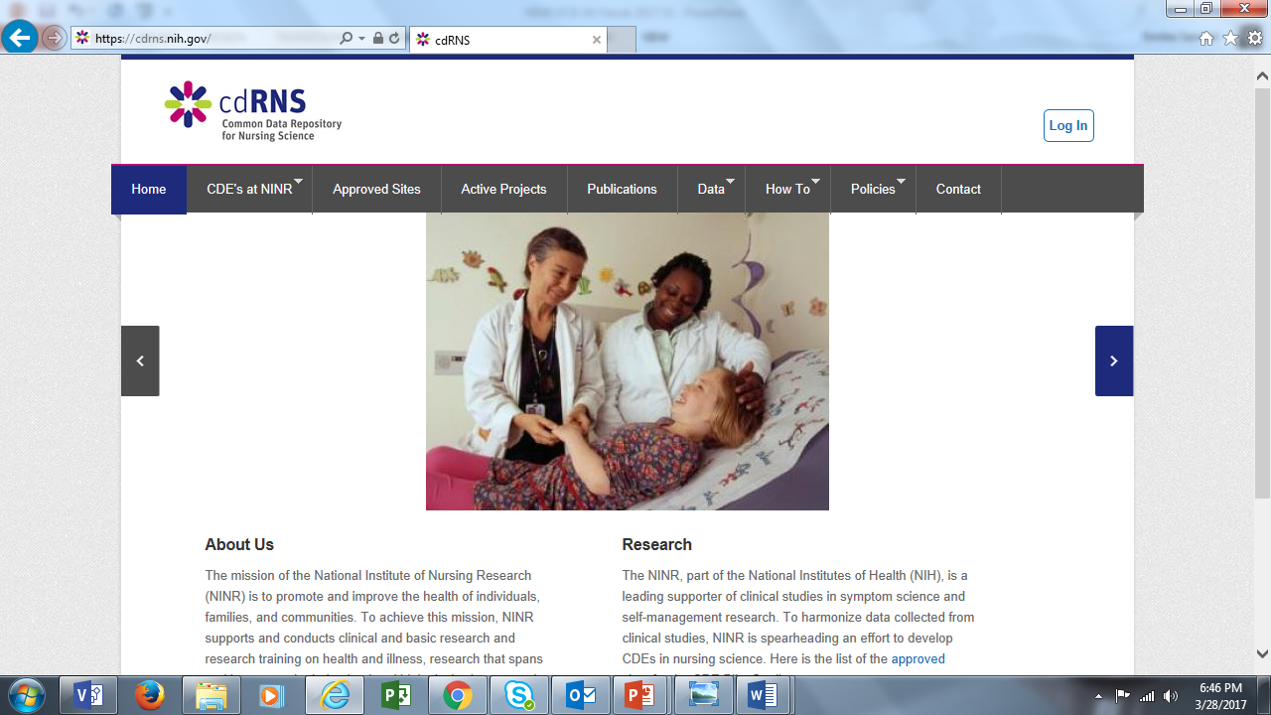

Slide 6
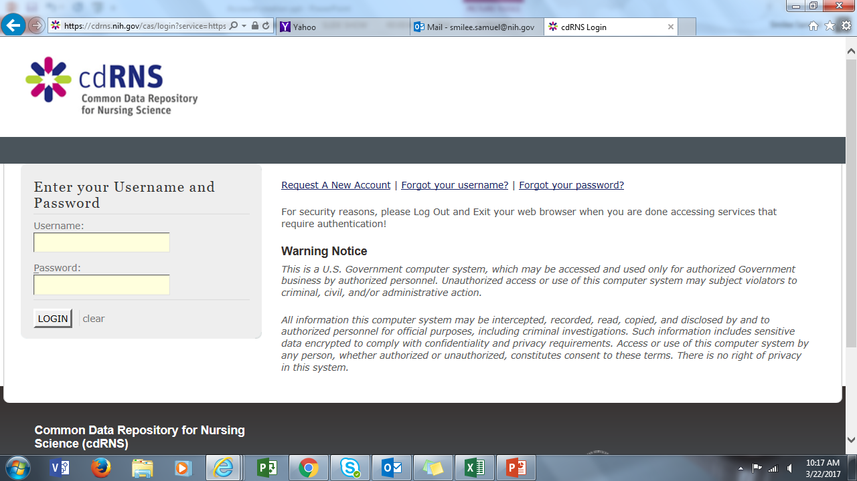

Slide 7
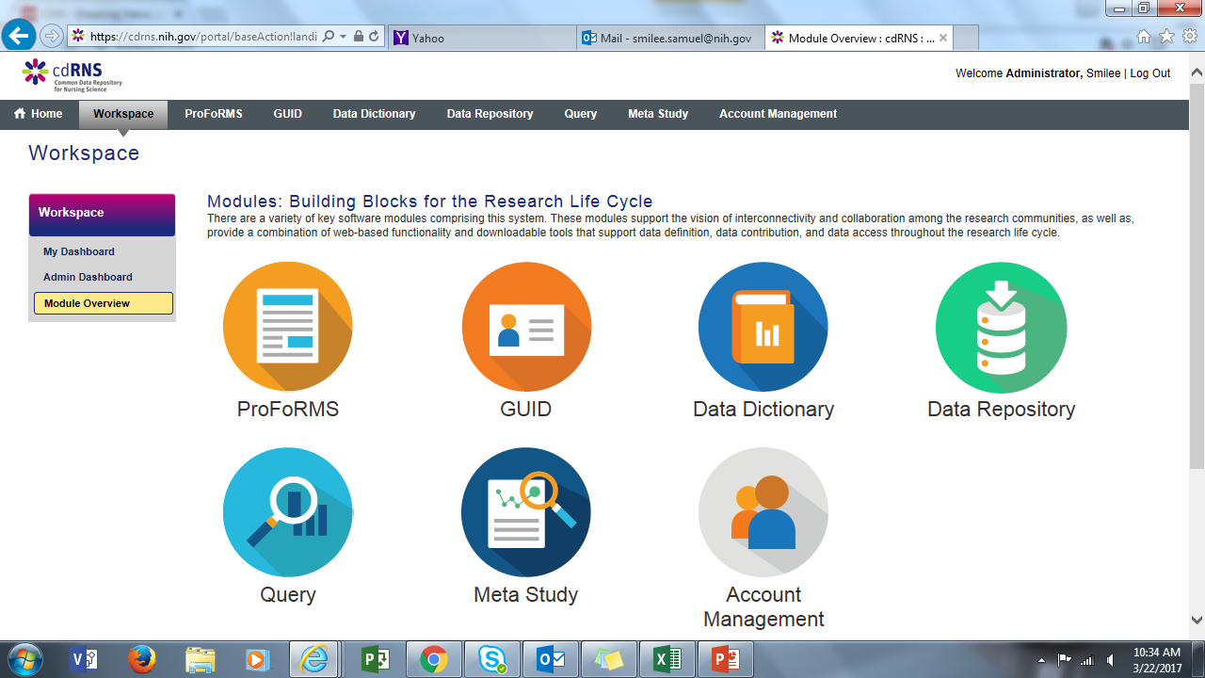

Slide 8
Order of progression
Select your study
Add a subject
Schedule a visit
Collect data

Slide 9
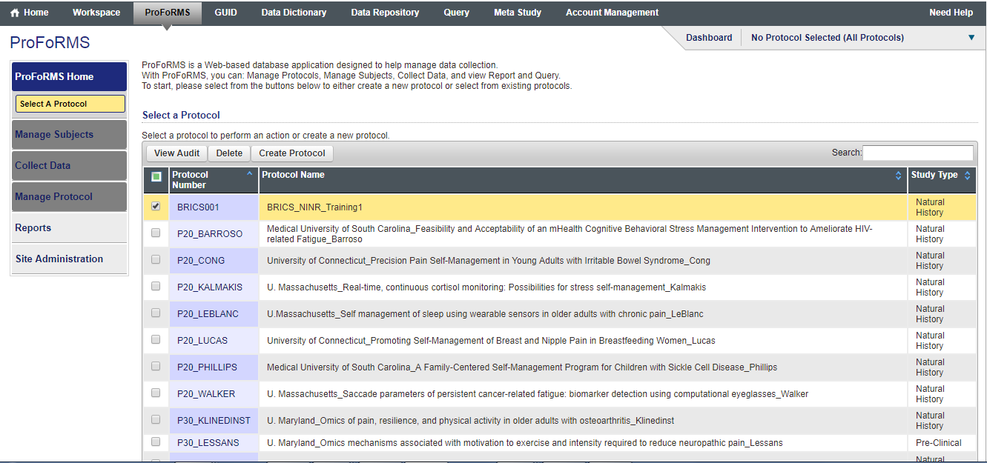

Slide 10
Add a Subject

Slide 11
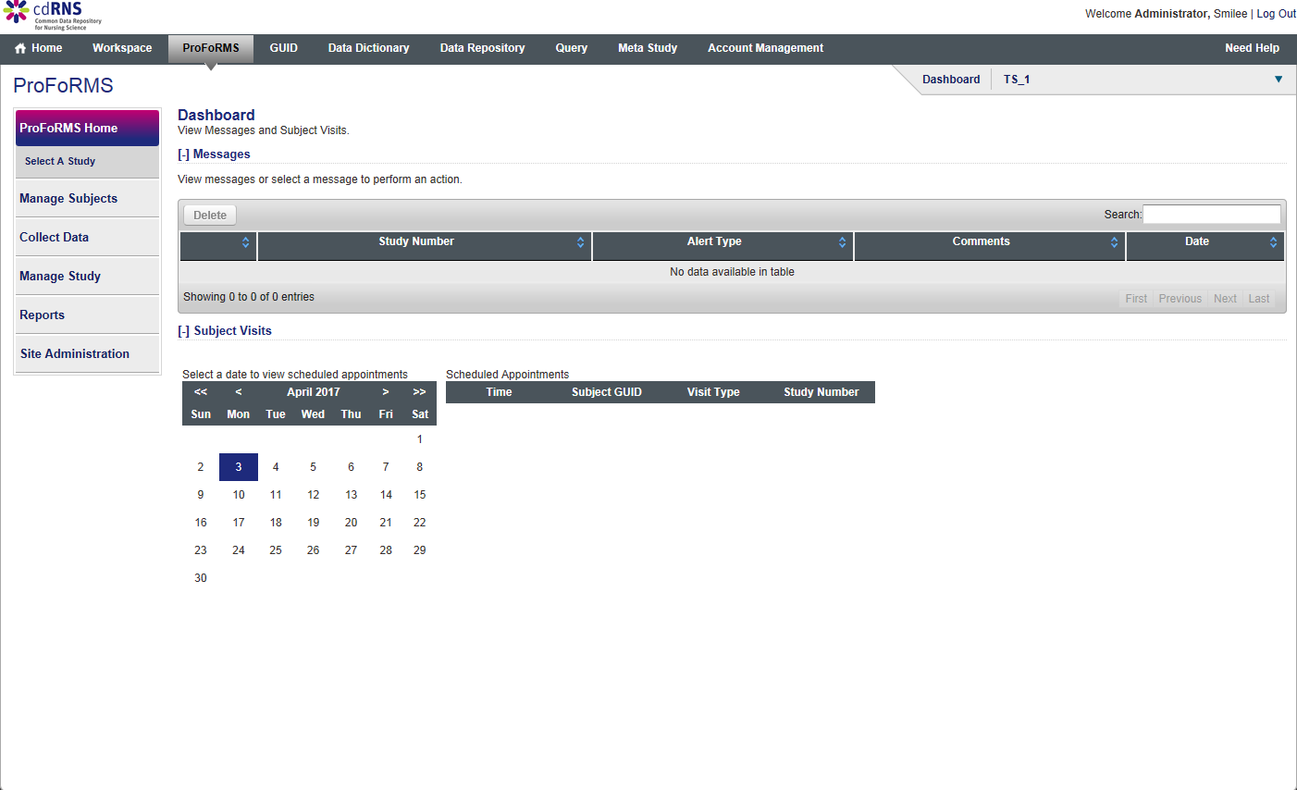

Slide 12
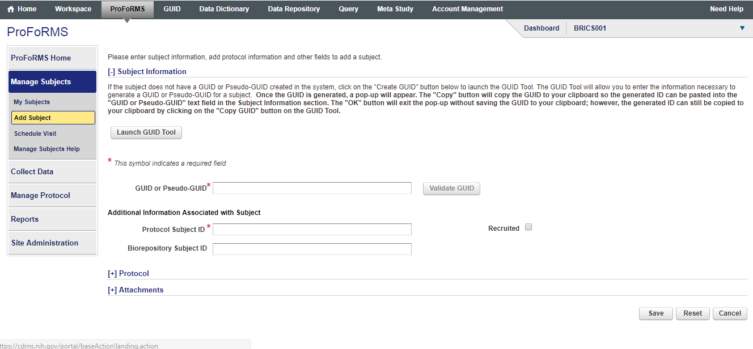

Slide 13
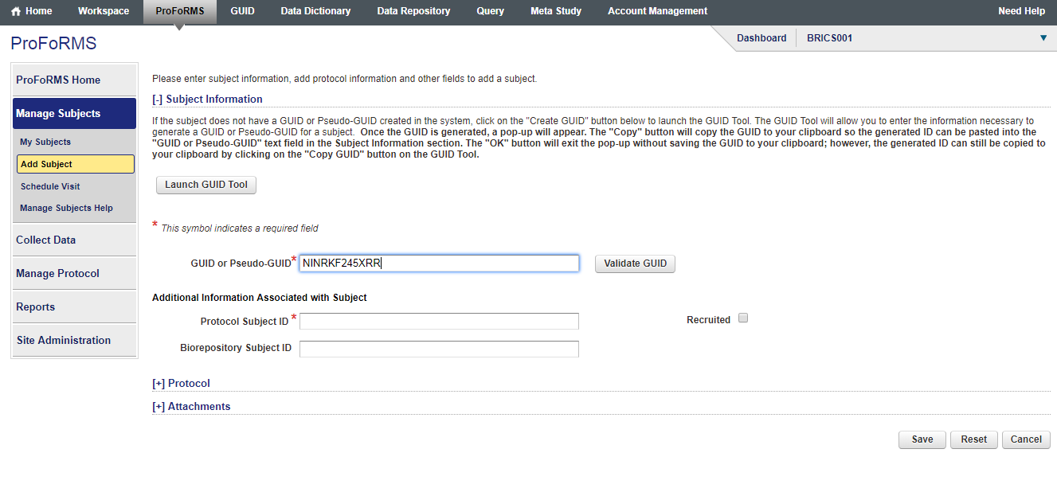

Slide 14
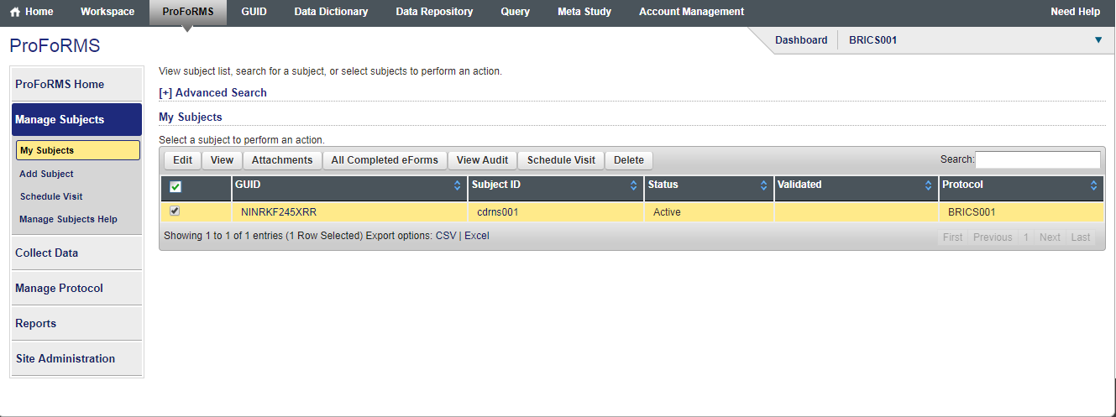

Slide 15
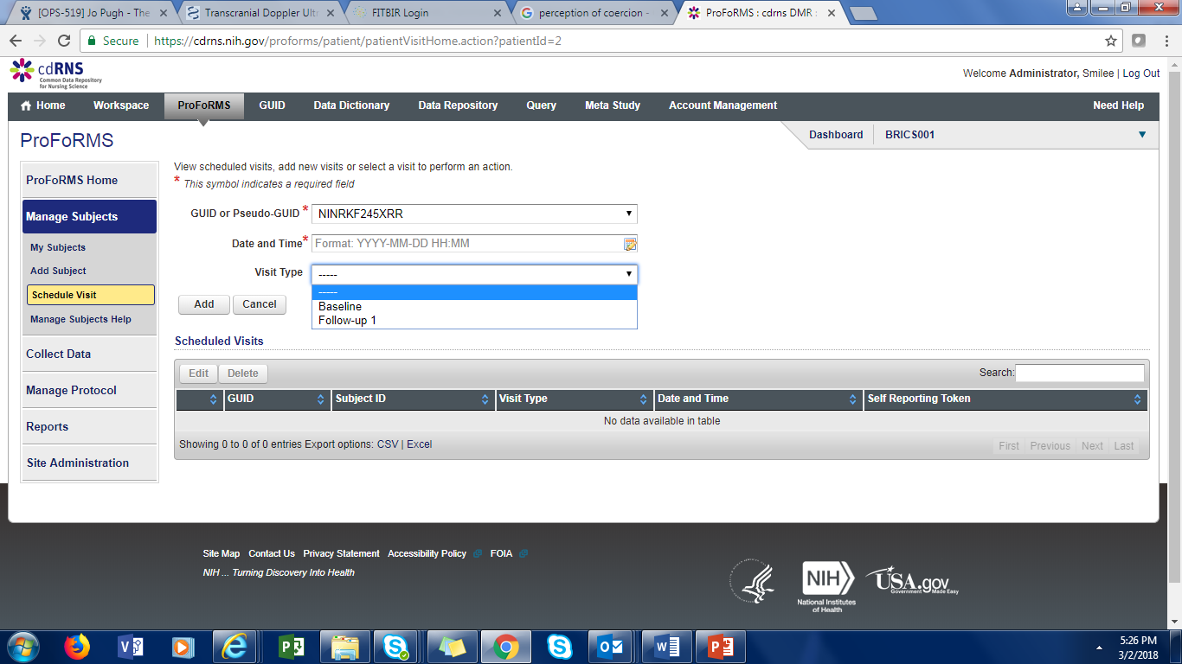

Slide 16
Collecting Data

Slide 17
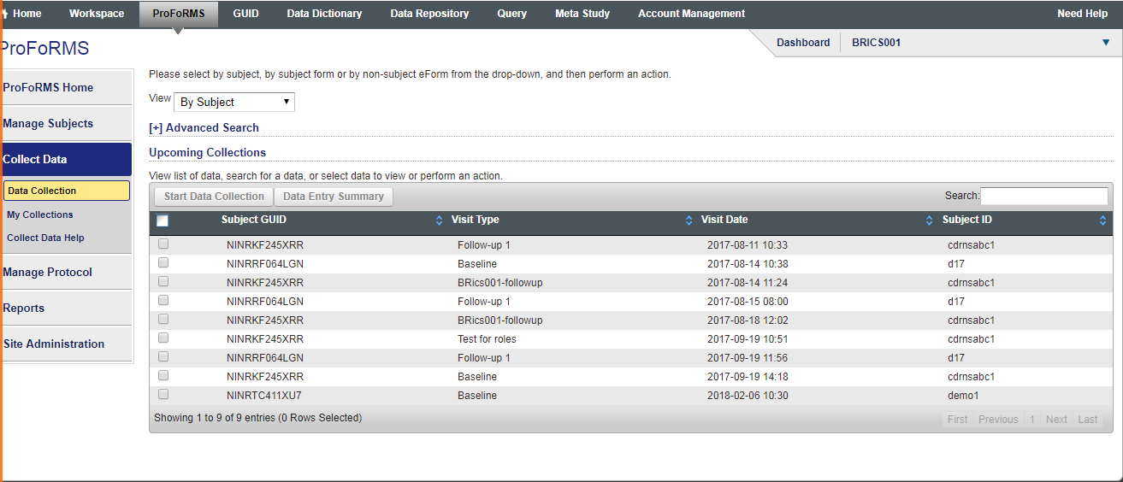

Slide 18
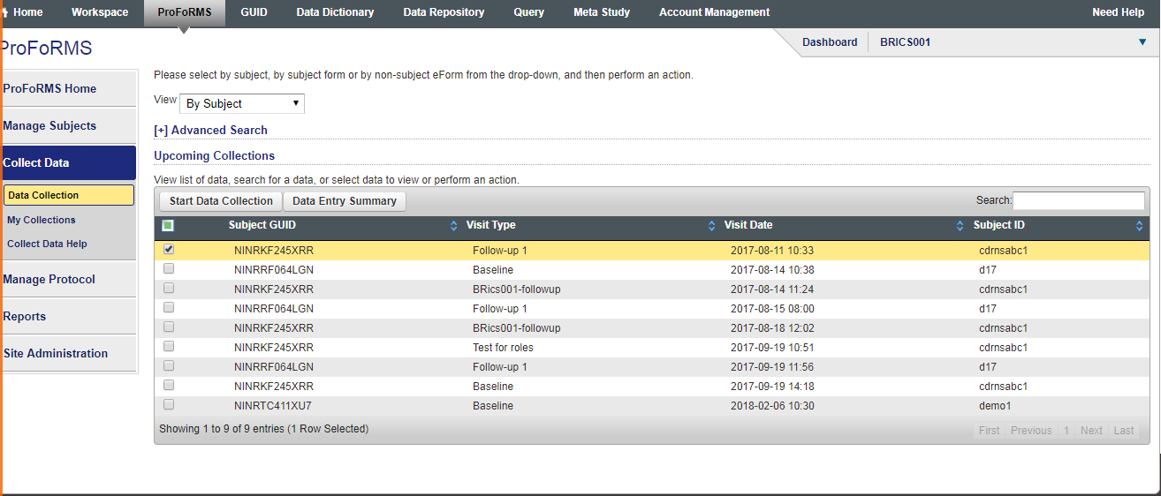

Slide 19
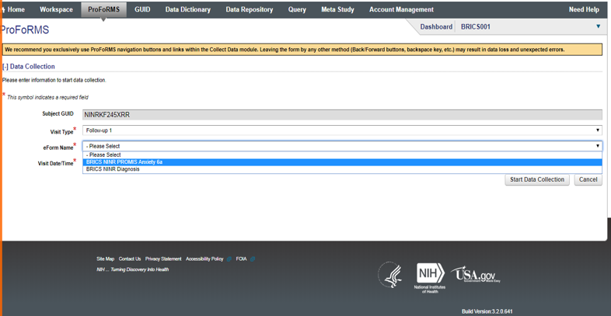

Slide 20
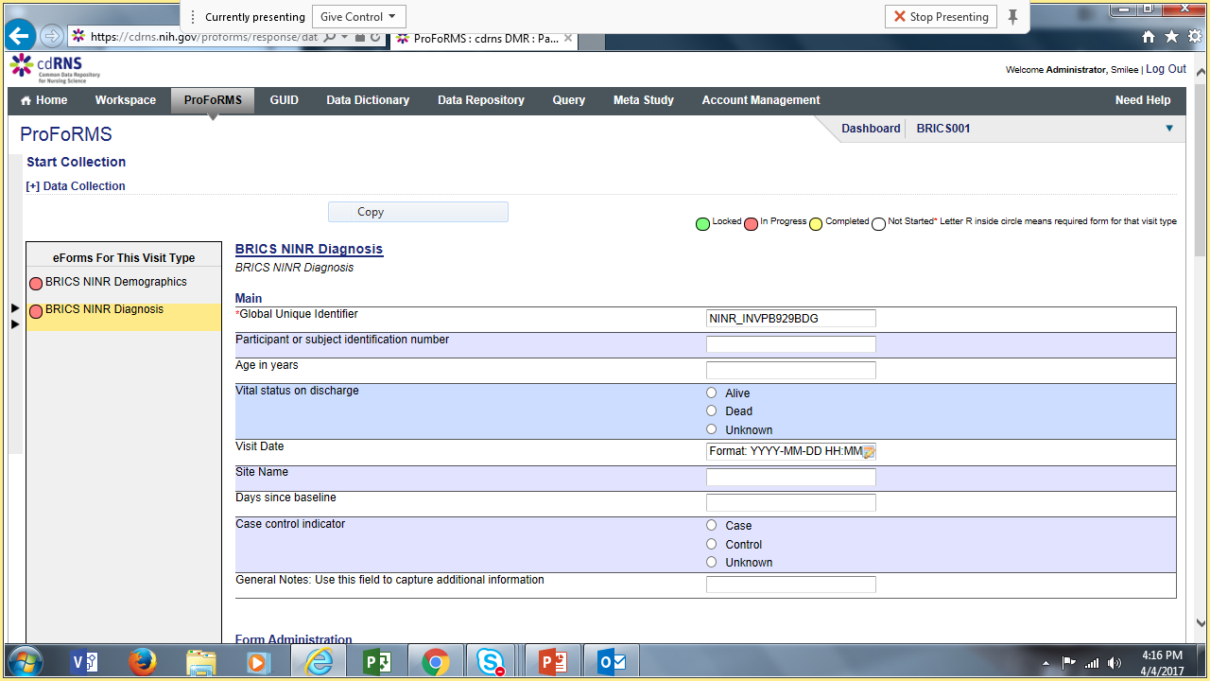

Slide 22
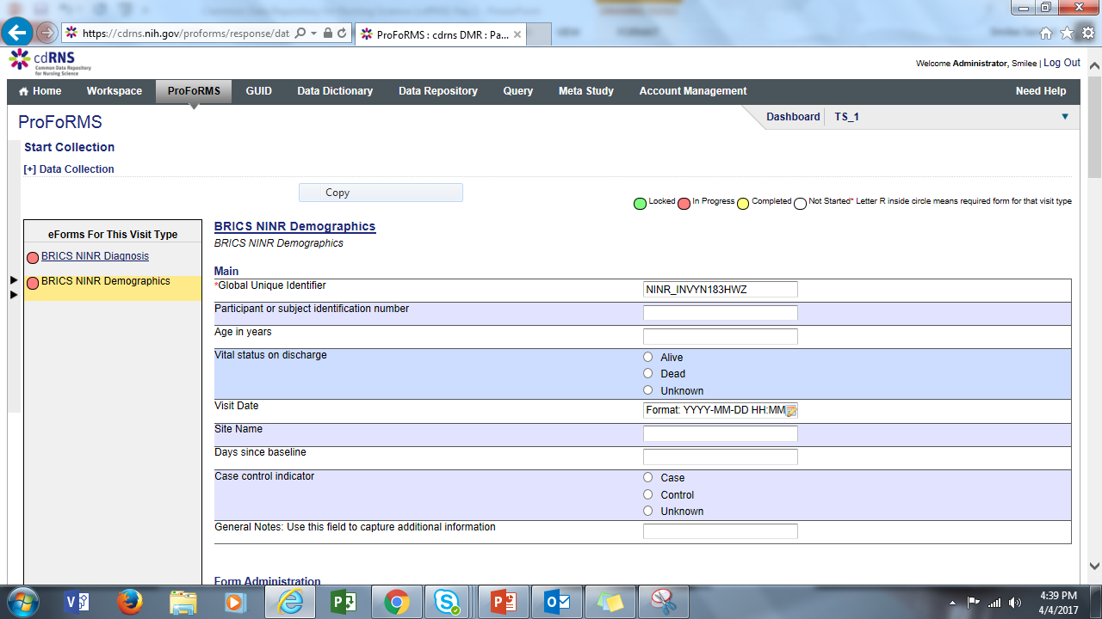

Slide 27
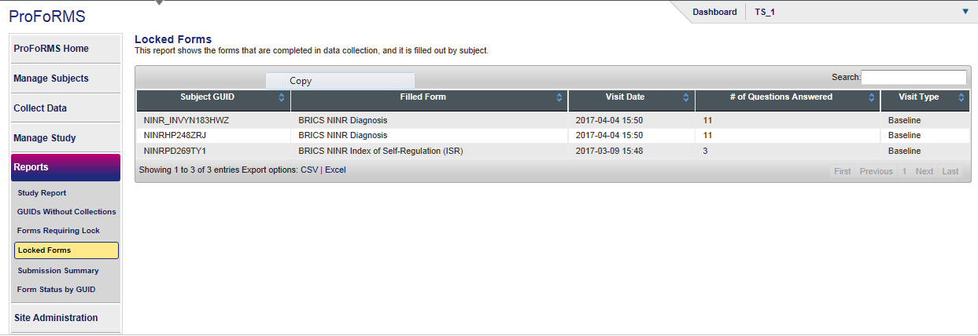

Slide 28
Re-entering data for a form that has already started data collection but was discontinued

Slide 29
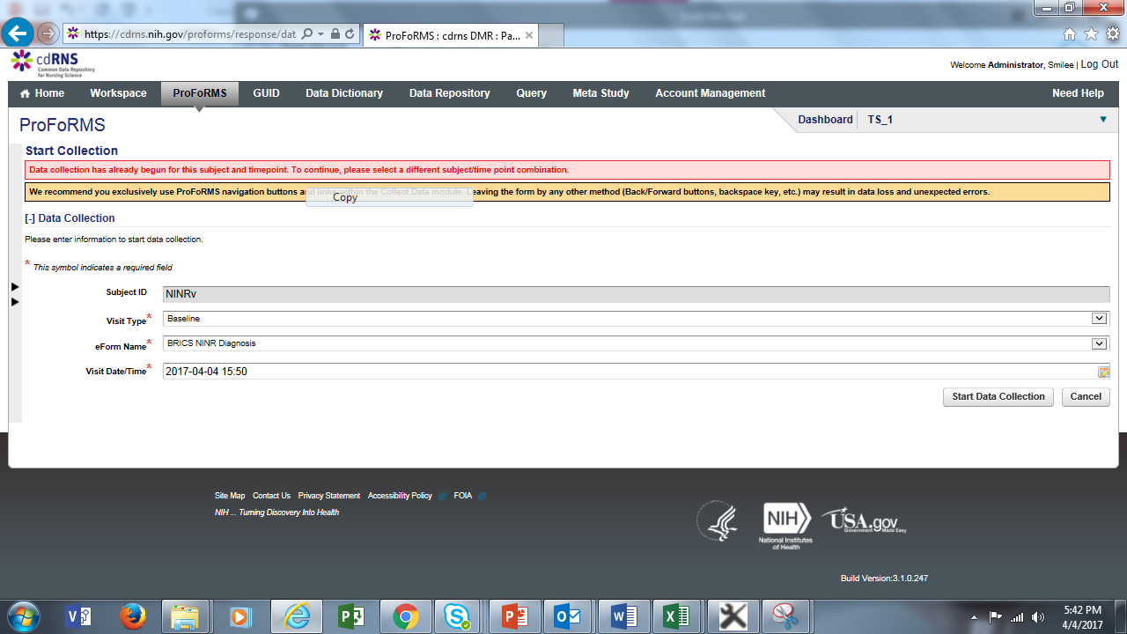

Slide 30
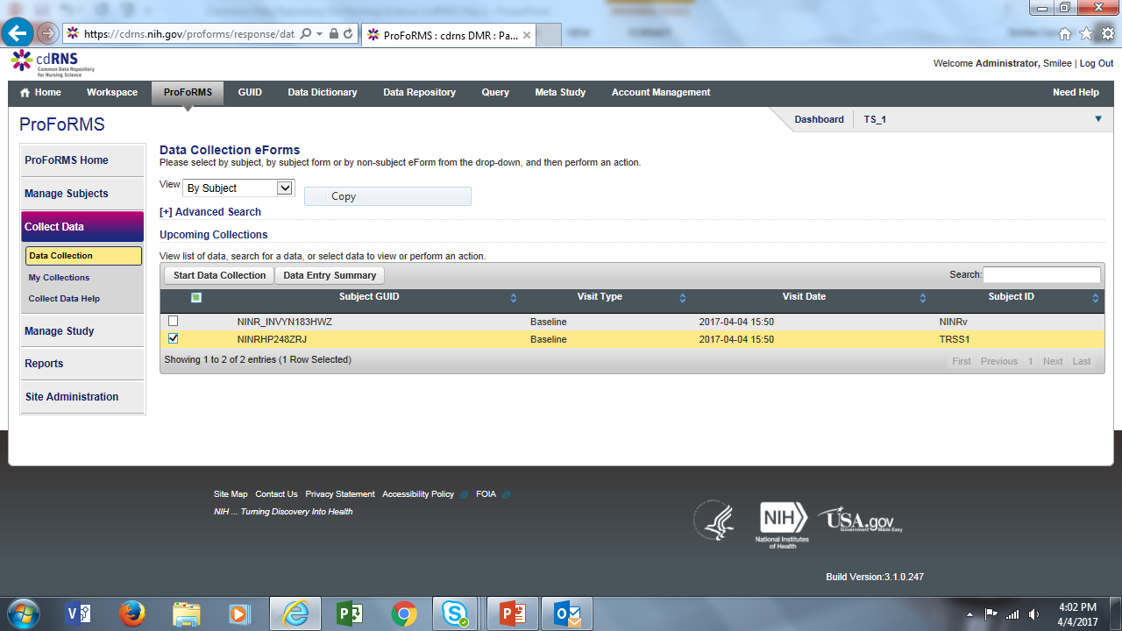

Slide 31
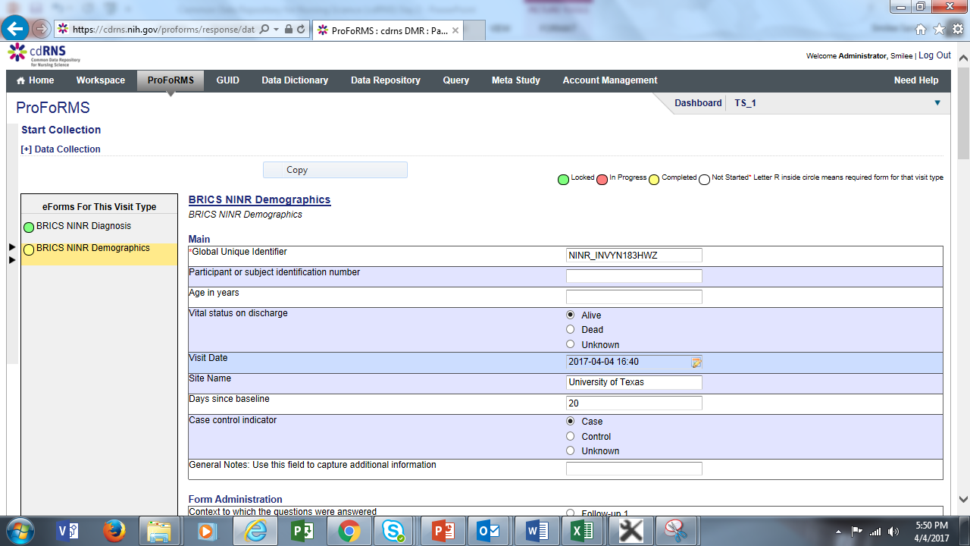

Slide 32
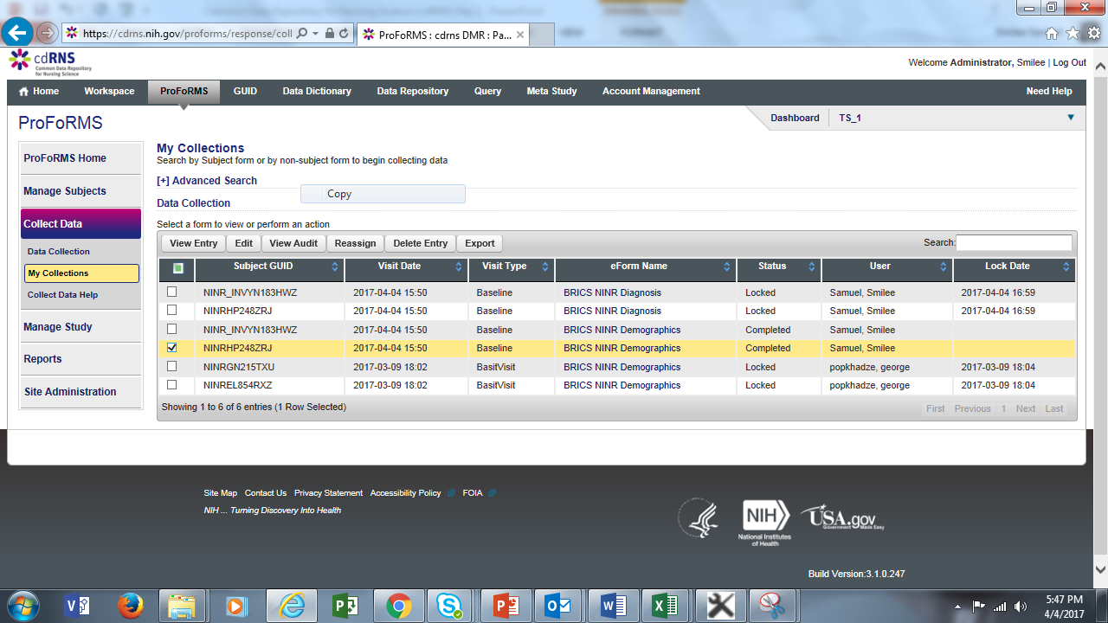
Step 2
Step1

Slide 33
SCHEDULE VISIT FOR A SUBJECT

Slide 35
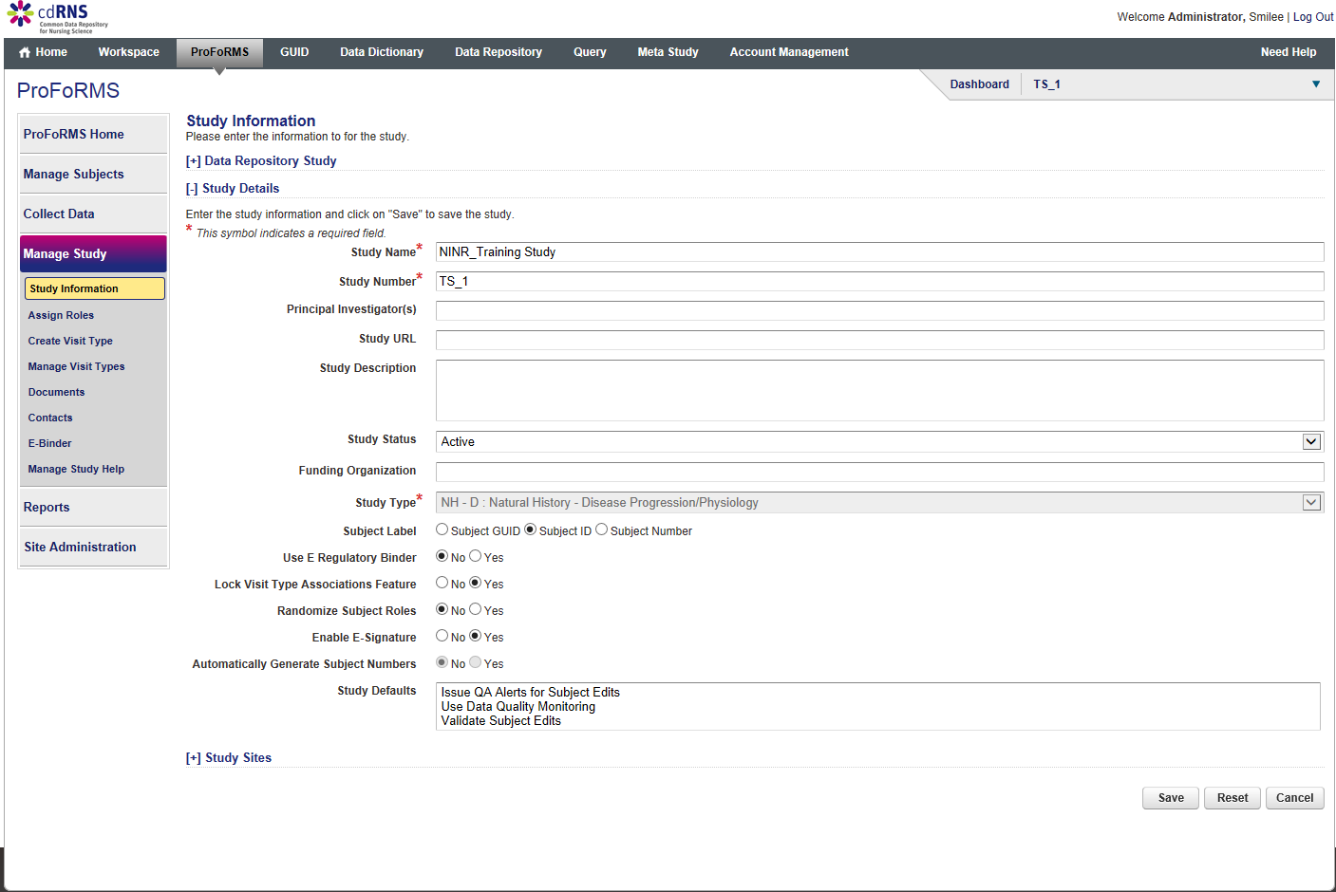

Slide 36
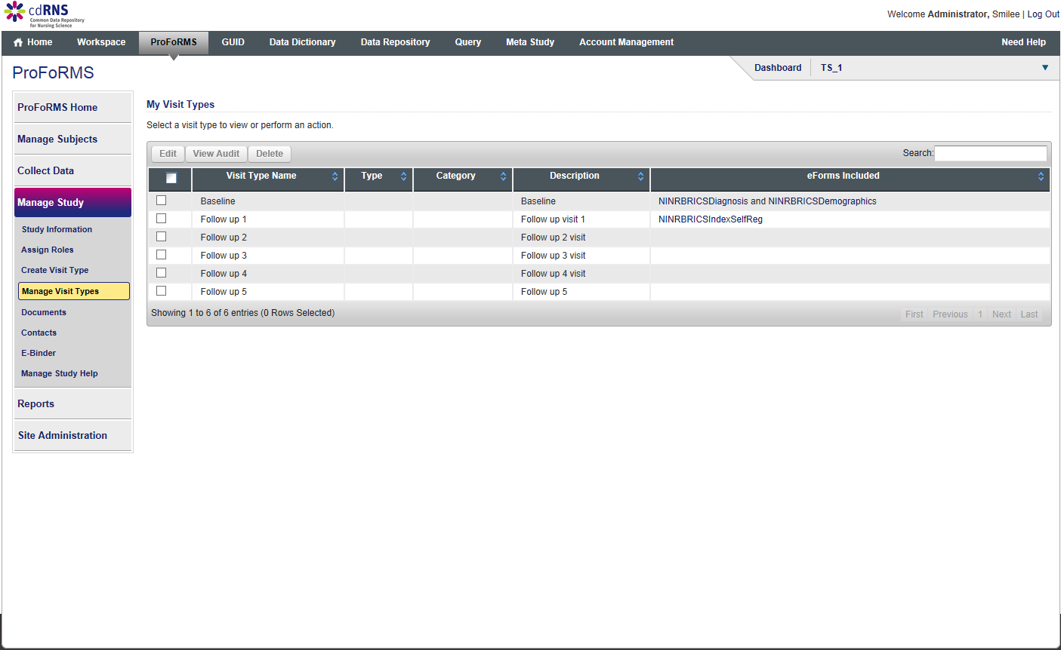

Slide 37
QUERY TOOL MODULE

Slide 41
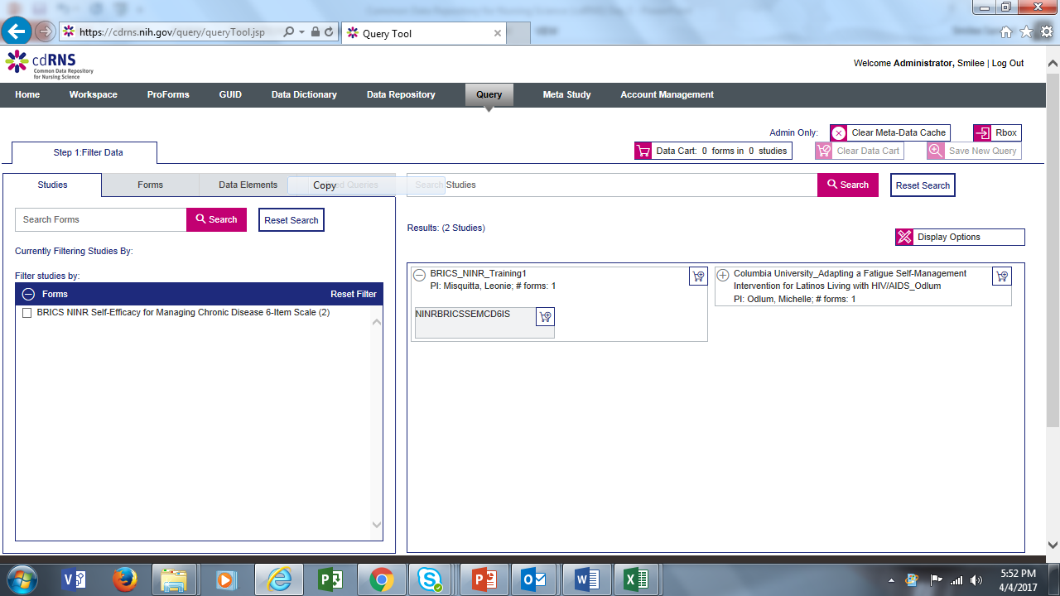

Slide 42
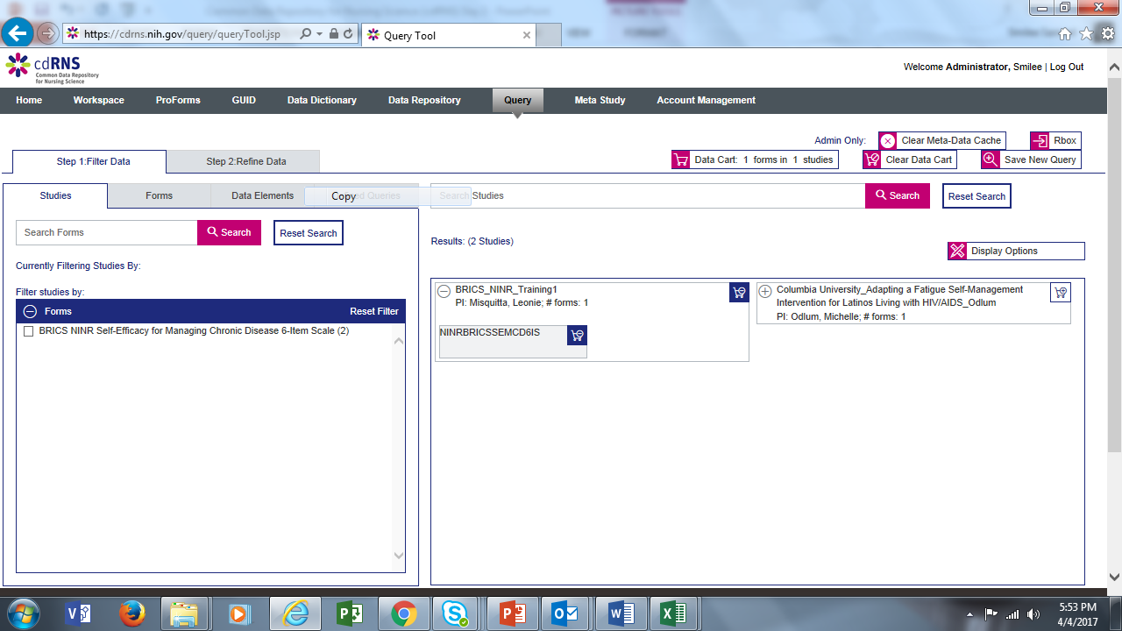

Slide 43
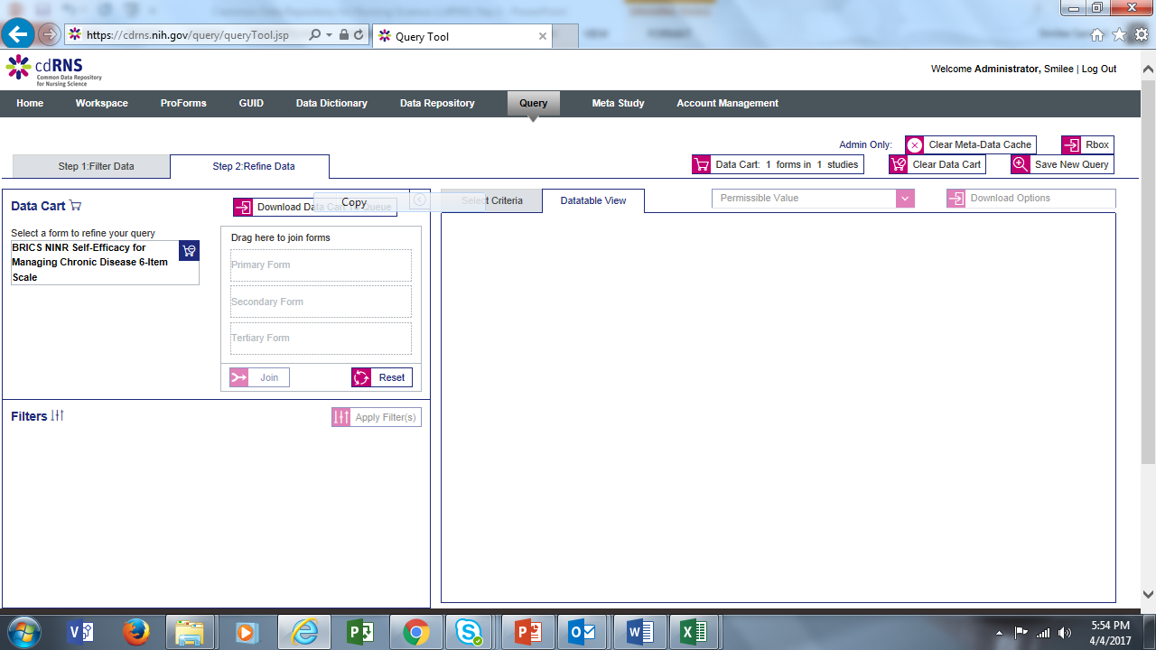

Slide 44
